Slide 1

What Makes a Good Classroom Blog / Website?
Alannah Hodi, Cassidy Johnson, Kelly Quinton, Lauren Olson

Slide 2




Table of Contents.
Comparisons
References
1
2
3
First, Lauren will talk about this! ;)
Kelly will talk about this second! :)
Then, Alannah will talk about this. :-)
4
5
6
After that Cassidy will talk about this.
Notes:
BLAHBLAH

Slide 3


Easy set up
Add all your students and link them to a parent.
Teachers, students and parents each have their own platform to work from.
Sweet Avatars for students to create.
Teachers can add photos, assignments and messages
Students can add photos and assignments.
Teacher
https://teach.classdojo.com/#/classes/63484ebeecdd0316e8577f74/points
Student
https://student.classdojo.com/#/story
https://watch.screencastify.com/v/6tEsJr93ACy5PkC5tBt9
Parent
https://home.classdojo.com/#/story

Slide 4
EASY TO SET UP/CREATE
  EASY TO EDIT
FREE
EASY TO ACCESS - DON’T NEED A SEPARATE APP OR LOGIN - EASY ON PARENTS (PUBLIC)
CAN BE USED BY STUDENTS AS WELL AS PARENTS
LIMITED EDITING OPTIONS
GOOD TO KEEP STUDENTS AND GUARDIANS UP TO DATE
https://drive.google.com/file/d/1iOB1FmfbkUeu3jfTAWfkCgyznLM45VJy/view
https://sites.google.com/view/technologyedpresentation/home

Slide 5
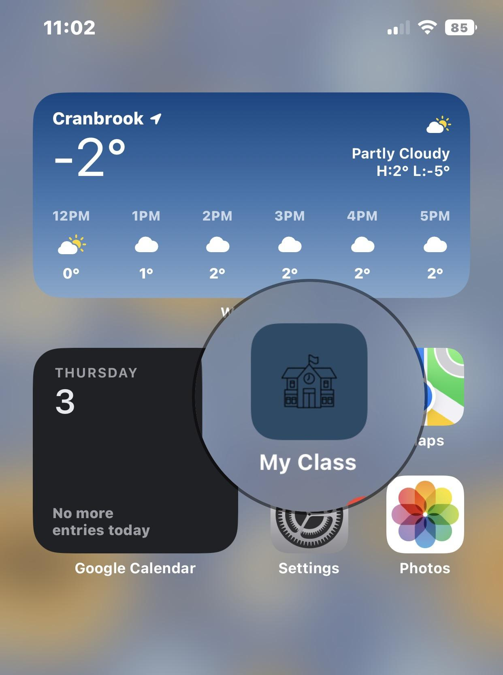
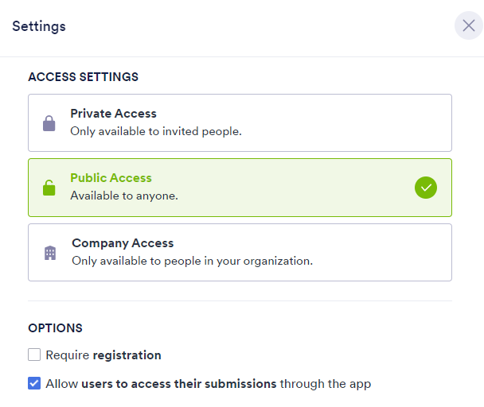

Parent-teacher communication
FREE for everyone
Accessed on pc (website) or smartphone (app)
Relatively easy to create & update
Private, public, or company use- can add registration
Fill and submit forms
Direct contact button
https://www.jotform.com/app/222845310520243
https://youtu.be/5gTormCBa_g

Slide 6
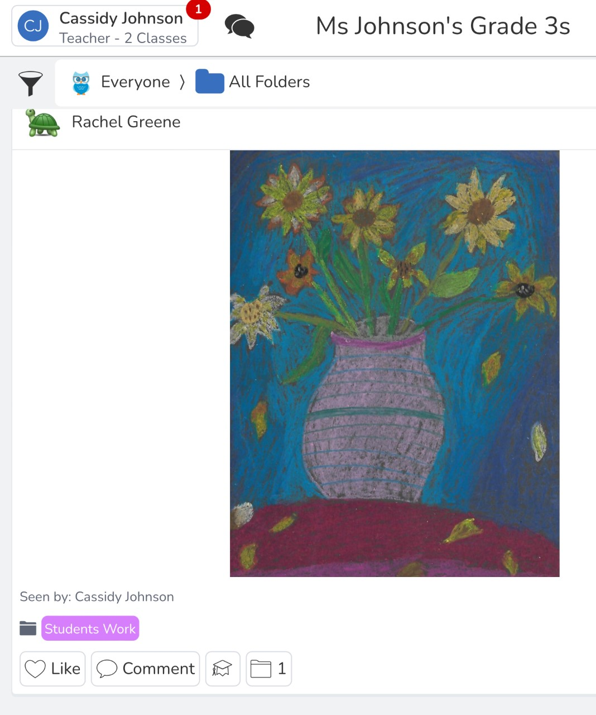
SET UP AN ACCOUNT AS THE TEACHER, AN ACCOUNT FOR EVERY STUDENT AND INVITE FAMILIES TO SET UP AN ACCOUNT TO ALLOW FOR OPEN COMMUNICATION
TEACH STUDENTS ABOUT PROFESSIONALISM ONLINE, TEACH THE STUDENTS WHEN TO SHARE AND WHEN NOT TO
CREATE FOLDERS FOR EASY ORGANIZATION OF STUDENT ACTIVITIES AND WORK
UPLOAD PERMISSION FORMS DIRECTLY TO THE PARENTS
CREATE ANNOUNCEMENTS AND CONVERSATIONS TO COMMUNICATE WITH PARENTS AND STUDENTS ABOUT UPCOMING EVENTS
TEACH STUDENTS TO USE TECHNOLOGY IN A SAFE PRIVATE MANNER
FOR MORE DETAILS AND A HOW TO USE TUTORIAL CLICK BELOW:
https://watch.screencastify.com/v/AvD2XVzWEmITIHm4UbQG
https://app.seesaw.me/#/class/class.560f6f3b-08b6-4212-a9f0-483ac284b767

Slide 7
1. cost
What kind of things make a class website or blog “good”?
Preferably FREE
2. accessibility
Is the website/blog easy for students/parents to navigate?
Can you view the website/blog from multiple devices?
3. privacy
Password protected?
Can anyone view the class blog/website?

Slide 8
 | FREE, PAID OPTION | -EASY TO NAVIGATE -AVAILABLE ON MULTIPLE DEVICE ACCESS -EASY EDIT | -PRIVATE PASSWORD PROTECTED. -PARENTS ONLY SEE THEIR CHILD’S WORK AND PICTURES | -GREAT RESOURCE FOR TEACHER PARENT COMMUNICATION -SOME FEATURES ARE NOT AVAILABLE UNLESS YOU PURCHASE PLUS .
 | FREE | -STRAIGHTFORWARD -EASY TO NAVIGATE -MULTIPLE DEVICE ACCESS | -PUBLIC WEBSITE - ANYONE CAN ACCESS CAN INVITE OTHERS TO EDIT/MANAGE - | -CONVENIENT and ACCESSIBLE -CAN’T BE USED FOR TWO WAY COMMUNICATION
 | FREE | -USE ON DIFFERENT DEVICES -EASY TO NAVIGATE -EASY ACCESS TO FORMS/INFO | -PUBLIC, PRIVATE, OR COMPANY USE -CAN BE PASSWORD PROTECTED -CAN REQUIRE REGISTRATION TO ACCESS | PROS: -EASY COMMUNICATION BETWEEN TEACHER AND PARENTS CONS: -NOT GEARED FOR STUDENT-USE
 | FREE PAID OPTION | -TEACHER, STUDENT AND FAMILY ACCOUNT OPTIONS - EASY TO NAVIGATE - ACCESS BY WEBSITE OR APP | -PRIVATE -ACCESS BY INVITE ONLY -PASSWORD PROTECTED LOGIN -SIGN IN MODE OPTIONS FOR AUTO LOGOUT OF ACCOUNT | -GREAT RESOURCE FOR COMMUNICATION BETWEEN TEACHER STUDENT AND FAMILY - PAID OPTION ALLOWS FOR STORAGE WITHIN CANADA
COST
ACCESS
PRIVACY
OTHER
Notes:
Dojoplus $60/ year

Slide 9
References
Class Dojo: https://www.classdojo.com/
Jotform: https://www.jotform.com/
Seesaw: https://app.seesaw.me
Google Sites: https://sites.google.com

